Slide 1

March 7, 2024
Sensing Sound with Light
Sagnac-Enhanced Laser Deflection Mechanism for Acoustic Detection
Ryan J Schlimme
Bachelor of Science, Computational Physics, May 2024
Raizen Lab
The University of Texas at Austin
Notes:
Interferometric Acoustic Detection

Slide 2
Acknowledgements
Dr. Mark G. Raizen
Dr. Logan E. Hillberry
Zachary I.E. Morrison

Slide 3
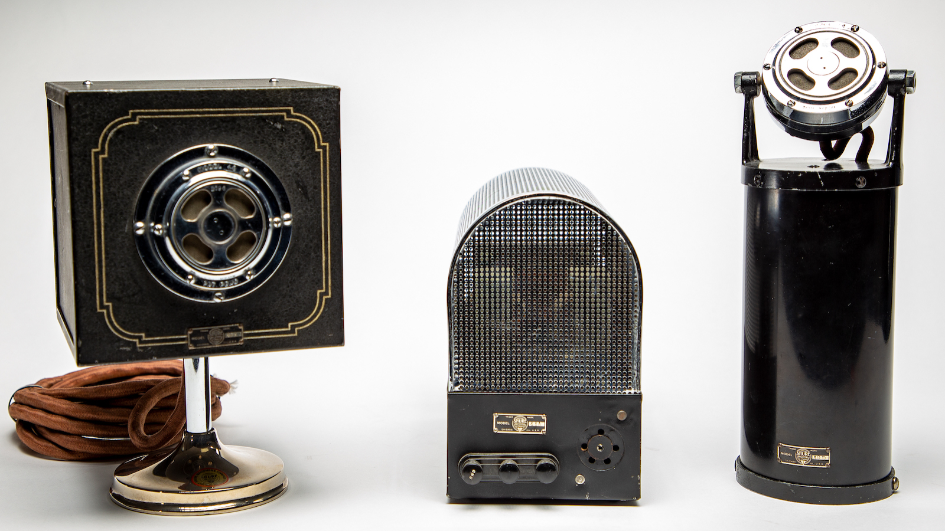

Slide 4
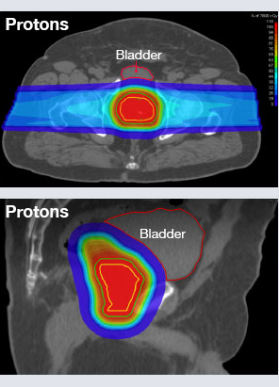
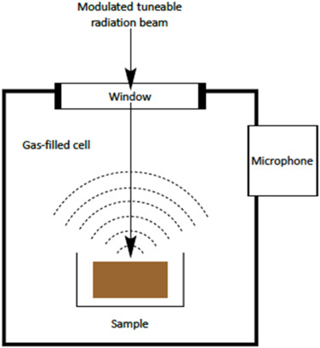
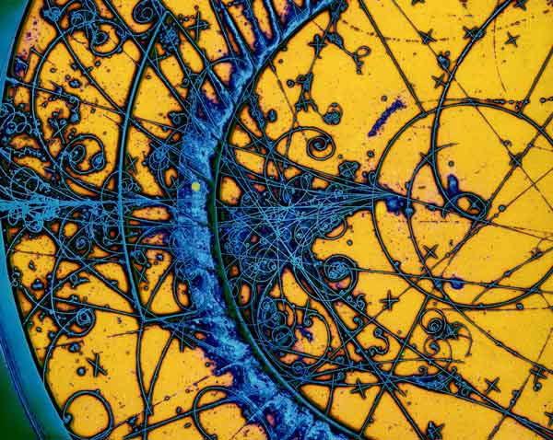
Photoacoustic Spectroscopy
Bubble Chamber
Proton Therapy
Notes:
Photoacoustic Spectroscopy: Studying the radiative absorption of matter via its acoustic response to a modulated laser beam. This is a picture of a common photoacoustic spectroscopy apparatus
Bubble chamber searches for dark matter have begun to use acoustic detectors. This is an example of a bubble chamber photo. Sounds can be used to discriminate the tracks
More accurate dosage monitoring for proton therapy for cancer treatment. As shown in the graphic, its typically not very targeted
Microphone is too bandwidth limited for these applications

Slide 5
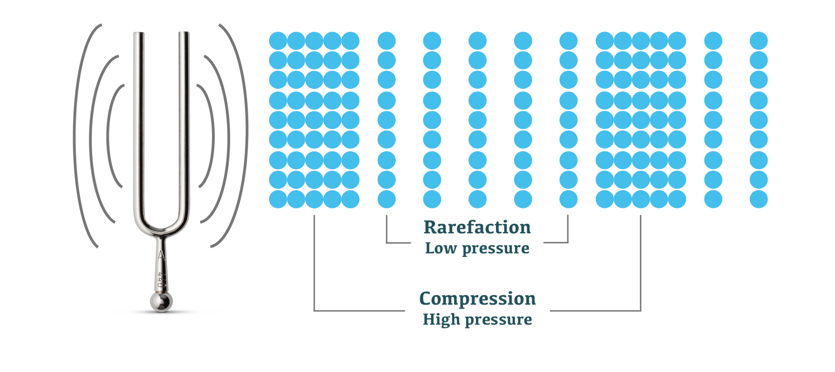

$$n∝ρ∝p$$
Notes:
Sound is a wave of continuously varying air density
Also pressure
These regions of compression and rarefaction cause regions of higher and lower refractive index

Slide 6
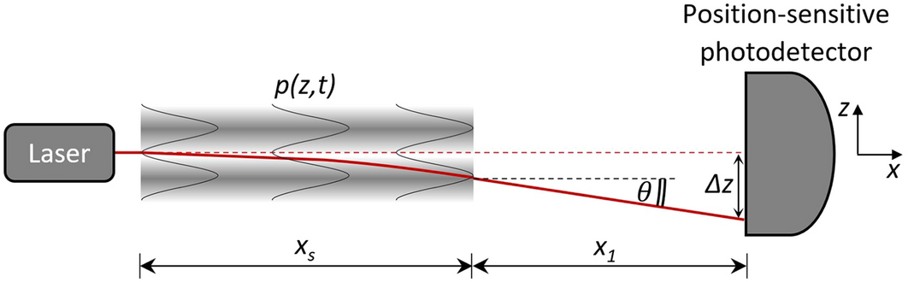

$$θ∝\frac{∂p}{∂t}$$
Gulino, MS., Bruzzi, M., Caron, J.N. et al. Non-contact ultrasonic inspection by Gas-Coupled Laser Acoustic Detection (GCLAD). Sci Rep 12, 87 (2022). https://doi.org/10.1038/s41598-021-04191-x
Notes:
These changes in refractive index cause the laser beam to deflect which can be measured using a variety of position-sensitive detectors

Slide 7
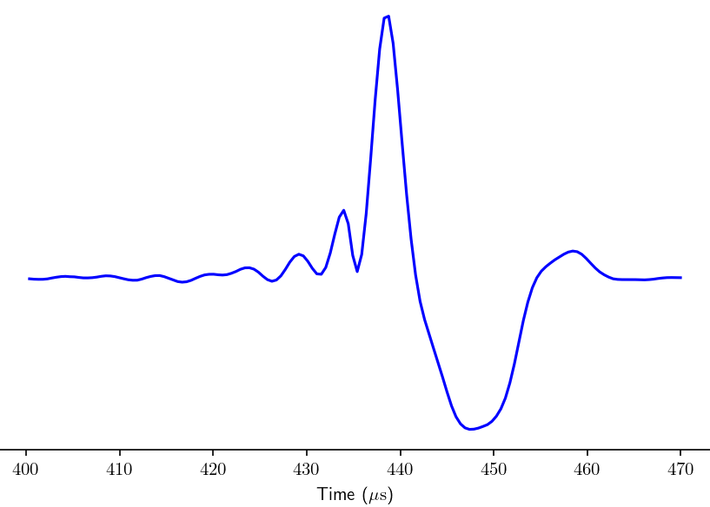
Arbitrary Voltage
Notes:
Here, we visualize a readout from a state of the art microphone with the highest available bandwidth of any microphone at 200 kHz
Vertical units of Pascal as specified by mic supplier
This is the signal from an impulsive sound generated from laser ablation, which we use as our test signal throughout experiment
All signals are digitized at 25 MHz, low pass filtered, and downsampled to a desired bandwidth in post processing

Slide 8
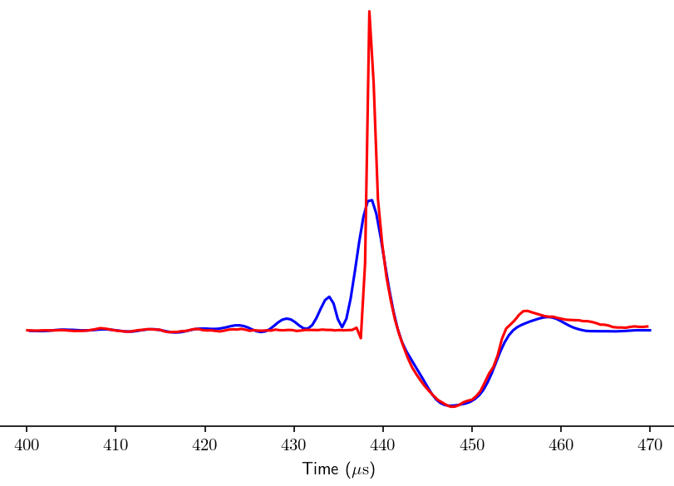
Arbitrary Voltage
Notes:
We overlay a laser signal

Slide 9
Arbitrary Voltage
Notes:
We developed a trough matching algorithm to scale up the laser by a constant factor, which we define as the sensitivity

Slide 10
Arbitrary Voltage
Notes:
To measure signal to noise ratio, we define signal as the maximum voltage of the ablation signal

Slide 11
Signal to Noise Ratio (SNR)
Arbitrary Voltage
Notes:
Then, we define noise as the root mean square of the pre-ablation signal
We can repeat this for many lowpass and downsampling cutoff frequencies to produce SNR graphs as a function of bandwidth

Slide 12
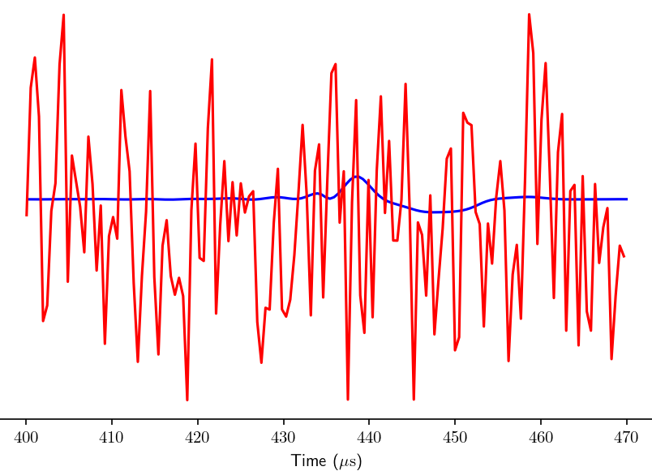
Arbitrary Voltage
Notes:
Historically, to increase bandwidth, you measure beam deflection using a cut mirror and a photodiode
Downside: you had to be very close
Produces noise dominated trace

Slide 13
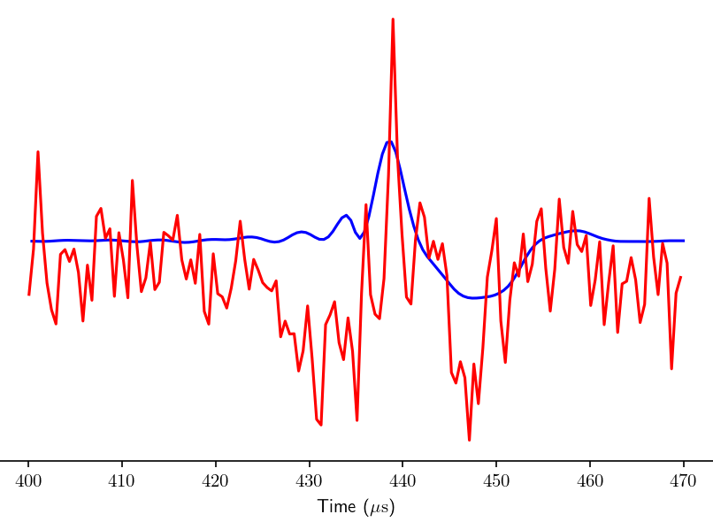
Arbitrary Voltage
Notes:
Only recover a signal through averaging of successive ablations
Does not allow for instantaneous measurement nor does it provide much resolution or bandwidth

Slide 14
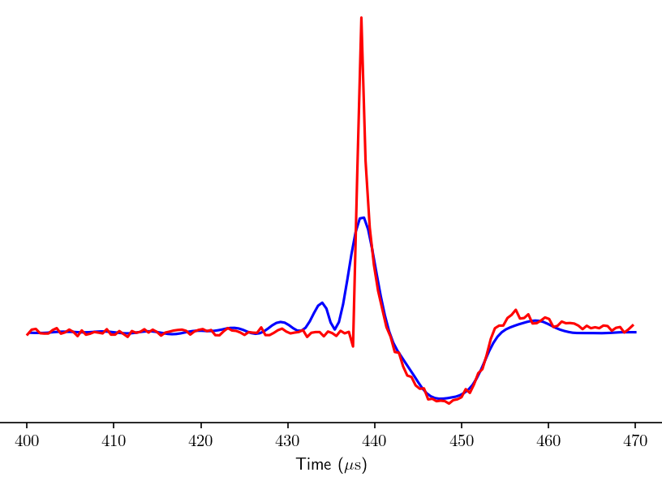
Arbitrary Voltage
Notes:
We recapture the redirected power into a subtractor circuit allowing for common mode noise rejection
Drastically improved resolution

Slide 15
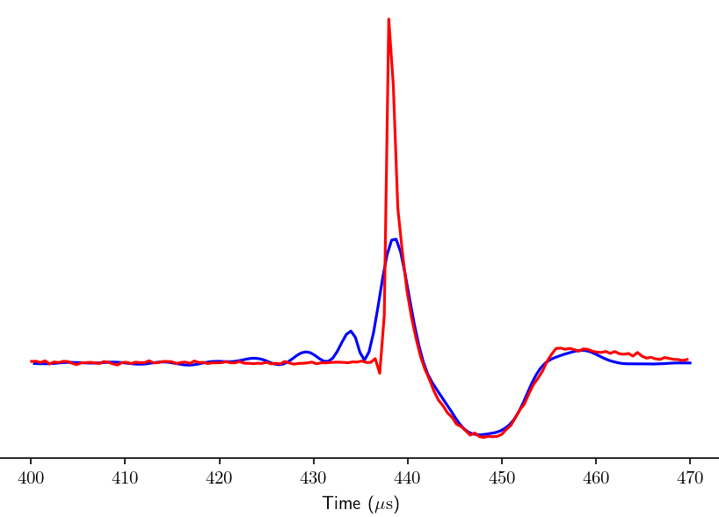
Arbitrary Voltage
Notes:
We use the Sagnac interferometer to further limit common mode noise by measuring from light exiting the dark port
This allows only information carrying photons to enter the detector

Slide 16
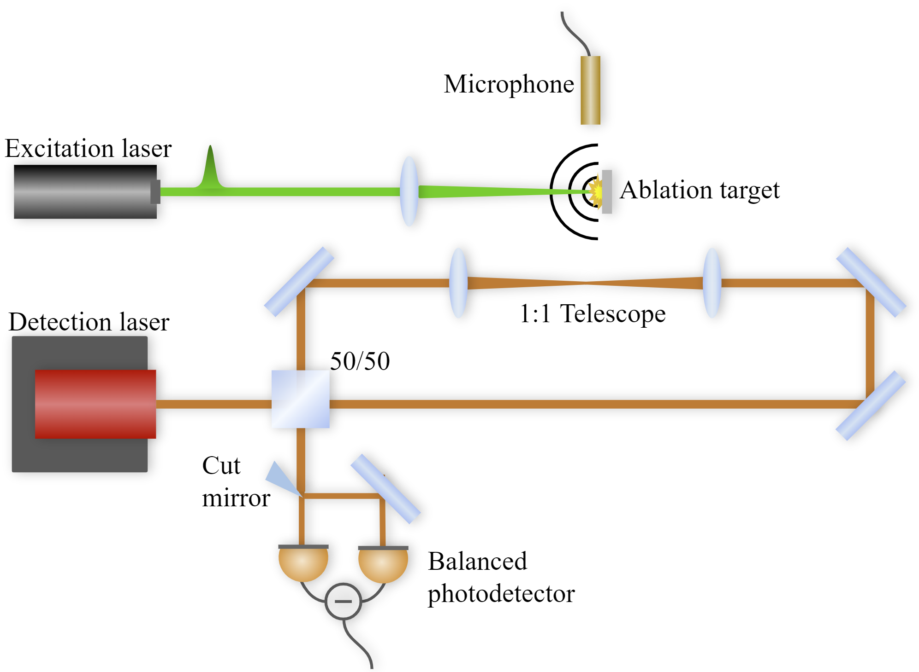
Notes:
5 ns, 7.5 mJ pulsed laser to ablate a metal target 10 cm from the detection beam and microphone
Measured using an industry leading microphone rated to 200 kHz to compare our detector to

Slide 17
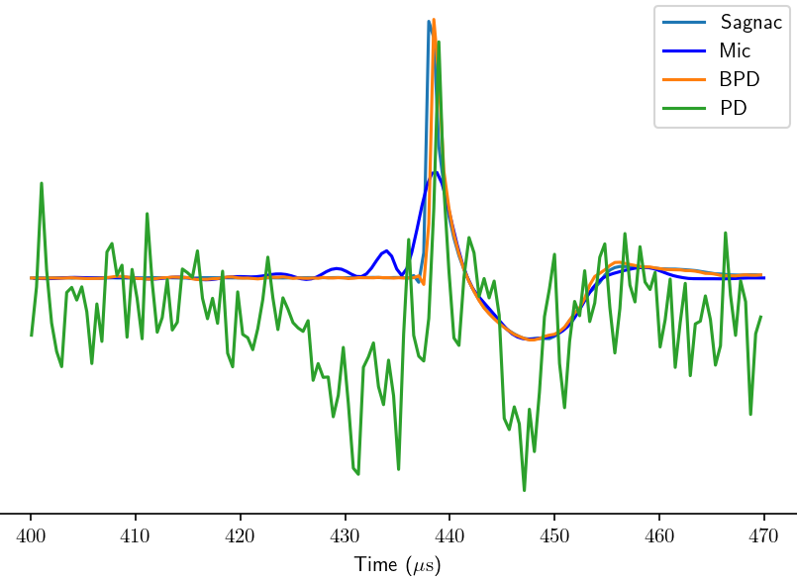
Arbitrary Voltage
Notes:
Visualizing all system traces on the same graph, we can see the stark improvement in clarity from just incorporating balanced photodetection
The improvement from the Sagnac is less clear in the time-domain

Slide 18
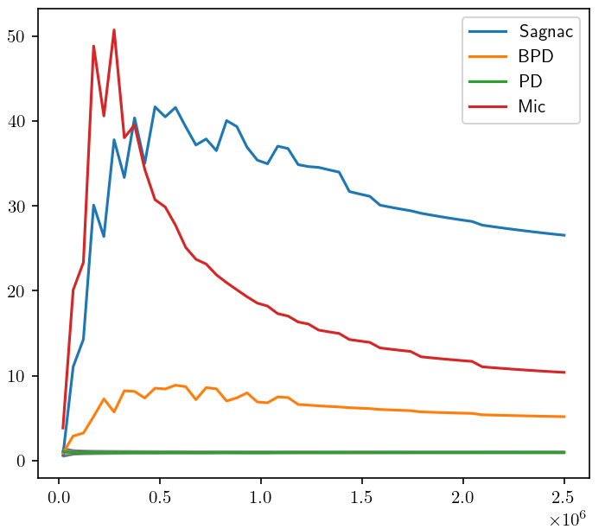
Signal-to-Noise Ratio (SNR)
SNR
Cutoff Frequency (Hz)
Notes:
When considering SNR, the Sagnac shows sustained high SNR comparable to the microphone, except at a much higher bandwidth
PD in Green: SNR ~1 for all bandwidths
Mic in Red: peak SNR ~50 for a bandwidth of 270 MHz, ~18 for 1 MHz
BPD in Orange: peak SNR ~8 for bandwidth 600 kHz, ~7 for 1 MHz
Sagnac in Blue: peak SNR ~40 for bandwidth 510 kHz, ~37 for 1 MHz
Lower Sagnac peak bandwidth may be a result of the sound source not containing frequencies much beyond that

Slide 19
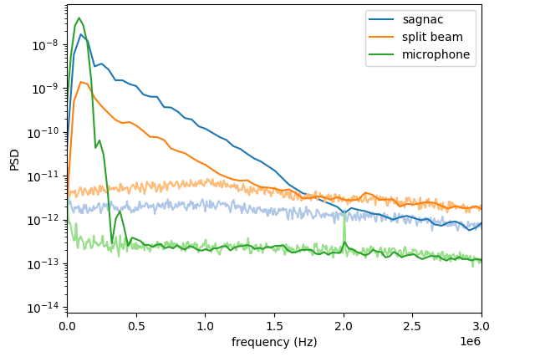
Power Spectral Density (PSD)
Notes:
We then considered power spectral density, a measure of the signal’s power as a function of frequency
We did not plot the single photodiode due to it PSD lying along the noise floor
Plotted is the PSD of the three systems compared to the PSD of their noise
Comparing PSD signal to PSD noise allows us to determine when we have a loss of signal
Comparing the split beam balanced photodetector to the microphone, we see the extended bandwidth, but slightly lower low-frequency resolution
However, the Sagnac has an even further bandwidth with very little low frequency resolution difference from the microphone

Slide 20
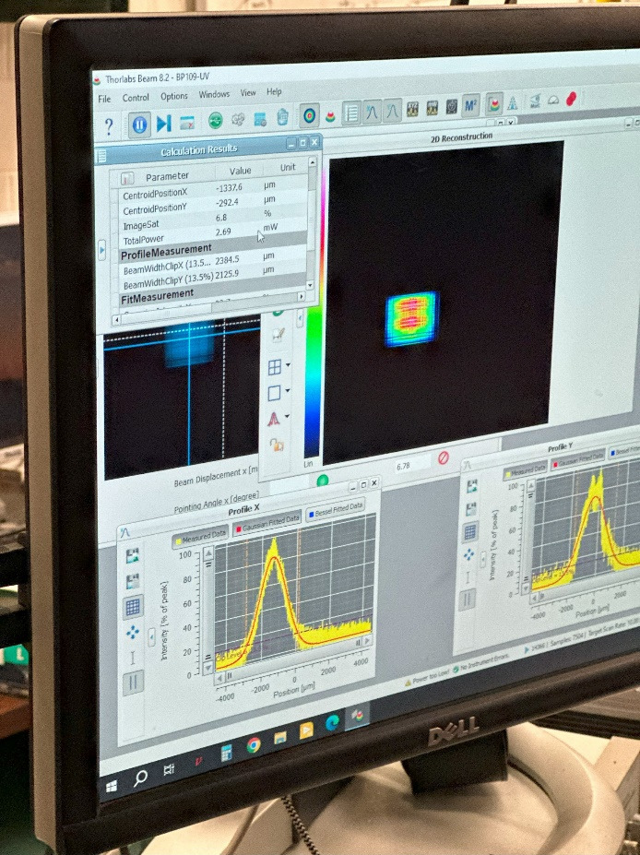
Key Conclusions
Previous Optical Methods -
High Bandwidth
Low Sensitivity
Our Advancement -
Increased Sensitivity
Maintained High Bandwidth
Enable Future Applications
Notes:
Previous state of the art optical methods like the balanced photodetection increased bandwidth but did not increase sensitivity due to the small perturbations it tries to measure
Sagnac increases sensitivity while maintaining high bandwidth standard of modern optical methods
This will enable future applications requiring both high bandwidth and high sensitivity
Possible Questions:
Why doesn’t it go to zero as it goes to 0 (saturates to constant value bc very strong signal)
In Mic signal what is ringing? (processing artifact, limited bandwidth of mic much lower than that of signal, distortions from limited BW and processing)
What about other interferometers? (Sagnac intrinsically stable to fluctuations outside of loop due to phase locking of forward and counter propagating loops, deflections IN loop are detected, Mach-Zender, Michelson rely on phase change in one arm in reference to another arm but unstable)

